Slide 1

Unit-2: Application Layer Part-2
Computer Networks (CN)
GTU #3150710
Prof. Maulik D Trivedi
Computer Engineering Department
maulik.trivedi@darshan.ac.in
+91-9998265805

Slide 2

Looping
Outline
Principles of Computer Applications
Web
HTTP
E-mail
DNS
Socket programming with TCP and UDP

Slide 3
User-Server interactions: Cookie

Slide 4

User-Server interactions: Cookie
A small text file that is stored in the user's computer either temporarily for that session only or permanently on the hard disk.
Cookies provide a way for the Web site to recognize you and keep track of your preferences.
The cookie technology has four components:
A cookie header line in the HTTP response message
A cookie header line in the HTTP request message
A cookie file kept on the user’s end system and managed by the user’s browser
A back-end database at the Web site
Use of Cookies
Authorization
Recommendations
User session state (Web, Email)
Shopping carts

Slide 5

Cookies - Example
client
server
ebay 8734
usual http request msg
server
creates ID
1678 for user
cookie file
usual http response
set-cookie: 1678
backend
database
create
entry
ebay 8734
amazon 1678
usual http request msg
cookie: 1678
cookie-
specific
action
access
usual http response msg
one week later:
access
ebay 8734
amazon 1678
usual http request msg
cookie: 1678
cookie-
specific
action
usual http response msg

Slide 6
Web Caches (Proxy Server)

Slide 7
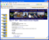

Web Caches (Proxy Server)
It satisfies HTTP requests on the behalf of an origin Web server.
The Web cache has its own disk storage and keeps copies of recently requested objects in this storage.
proxy
server
HTTP request
HTTP request
client
origin
server
HTTP response
HTTP response
HTTP request
HTTP response
client
origin
server

Slide 8
Web Caches (Proxy Server) – Cont...
A user’s browser can be configured so, user’s HTTP requests are first directed to the Web Cache.
A browser sends all HTTP requests to cache.
As an example, suppose a browser is requesting the object http://www.someschool.edu/campus.gif
Object in cache returns to client browser.
Otherwise cache requests object from origin server, then returns object to client browser.
Reduce response time for client request.
Reduce traffic on an institution’s access link.
Internet dense with caches: Insufficiency for content providers to effectively deliver content.

Slide 9
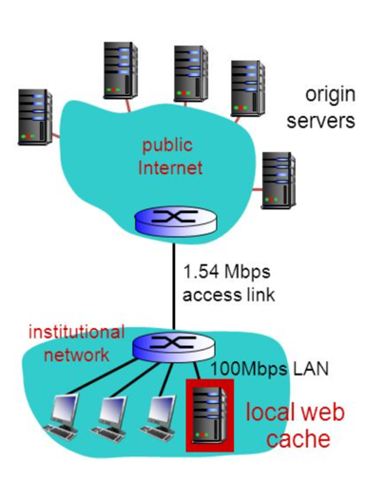
Web Caches (Proxy Server) – Example
Example: Institutional Network and Internet
Reduce response time for client request.
Reduce traffic on an institution’s access link.
Internet dense with caches: Insufficiency for content providers to effectively deliver content.

Slide 10
FTP (File Transfer Protocol)

Slide 11
FTP (File Transfer Protocol)
File Transfer Protocol (FTP) is the commonly used protocol for exchanging files over the Network or Internet.
Example: Filezilla
FTP uses the Internet's TCP/IP protocols to enable data transfer.
FTP uses client-server architecture.
FTP promotes sharing of files via remote computers with reliable and efficient data transfer.
FTP user interface
FTP client
File transfer
FTP server
User or Host
Local file system
Remote file system

Slide 12

FTP (File Transfer Protocol) – Cont…
FTP client connect FTP server at port 21 using TCP.
FTP uses two parallel TCP connections to transfer a file,
Control Connection: Used for sending control information between two hosts.
Data Connection: To send a file.
Control Information like user identification, password, commands to change remote directory, commands to “put” and “get” files
Client will browse remote file directory, sends commands over control connection.
FTP server maintains “state” about user like current directory, earlier authentication.

Slide 13
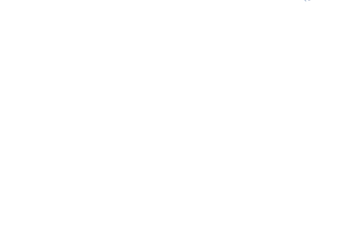
FTP (File Transfer Protocol) – Example

Slide 14
Electronic Mail (Email)

Slide 15
Electronic Mail (Email)
Email is an asynchronous communication medium in which people send and read messages as convenient for them.
Modern Email has many powerful features like:
A messages with attachments
Hyperlinks
HTML-formatted text
Embedded photos
Email is fast, easy to distribute, and inexpensive.
High level view of Internet mail system and its key components.
User agents
Mail servers
Simple Mail Transfer Protocol (SMTP)

Slide 16

Email - Cont…
User Agent
User agents allow users to read, reply to, forward, save, and compose messages.
E.g. Microsoft Outlook and Apple Mail.
Mail servers:
A mailbox contains incoming messages for user.
A message queue of outgoing (to be sent) mail messages.
SMTP
It is a principal application layer protocol between mail servers to send email messages.
client: sending mail to server
server: receiving mail from other different mail server
user
agent
mail
server
user
agent
SMTP
mail
server
user
agent
SMTP
SMTP
user
agent
mail
server
user
agent
user
agent
Outgoing
message queue
user mailbox

Slide 17
SMTP
Simple Mail Transfer Protocol used in sending and receiving e-mail.
It use TCP to reliably transfer email message from client to server using port 25.
It restricts the body (not just the headers) of all mail messages to simple 7-bit ASCII.
SMTP does not use intermediate mail servers for sending mail.
If receiving end mail server is down, the message remains in sending end mail server and waits for a new attempt.

Slide 18
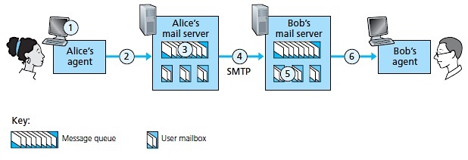
SMTP - Example
Alice uses user agent to compose message to computer@darshan.ac.in
Alice’s user agent sends message to her mail server; message placed in message queue.
Client side of SMTP opens TCP connection with Bob’s mail server.
4. SMTP client sends Alice’s message over the TCP connection.
5. Bob’s mail server places the message in Bob’s mailbox.
6. Bob invokes his user agent to read message.
1) Alice uses user agent to compose message to computer@darshan.ac.in
2) Alice’s user agent sends message to her mail server; message placed in message queue.
3) Client side of SMTP opens TCP connection with Bob’s mail server
4) SMTP client sends Alice’s message over the TCP connection
5) Bob’s mail server places the message in Bob’s mailbox
6) Bob invokes his user agent to read message

Slide 19
Mail Access Protocols (POP3 and IMAP)
POP3
Post Office Protocol – Version 3
IMAP
Internet Mail Access Protocol
A mail access protocol, such as POP3, is used to transfer mail from the recipient’s mail server to the recipient’s user agent.

Slide 20
POP3 – Post Office Version 3
POP3 is an extremely simple mail access protocol.
With the TCP connection established, POP3 progresses through three phases: authorization, transaction and update.
In authorization, the user agent sends a username and a password to authenticate the user.
In transaction, the user agent retrieves messages, mark messages for deletion, remove deletion marks and obtain mail statistics.
In update, after the quit command by client, ending the POP3 session; the mail server deletes marked messages.
POP3 is designed to delete mail on the server as soon as the user has downloaded it.

Slide 21
IMAP - Internet Mail Access Protocol
To keeps all messages in one place: at server
The recipient can then move and organize the message into a new, user-created folder, read the message, delete the message, move messages from one folder to another and so on.
To allow users to search remote folders for messages matching specific criteria.
Also permit a user agent to obtain components of messages, When low-bandwidth connection between the user agent and its mail server.
In this case, user not to download all the messages in its mailbox, particularly avoiding long messages like an audio or video clip.

Slide 22
DNS - Domain Name System

Slide 23
DNS - Domain Name System
It is an internet service that translates domain names into IP addresses.
It is application-layer protocol. DNS service must translate the domain name into the corresponding IP address.
In DNS system, If one DNS server doesn't know how to translate a particular domain name, it asks another one, and so on, until the correct IP address is returned.
Alphabetic name remember by human
IP Address

Slide 24
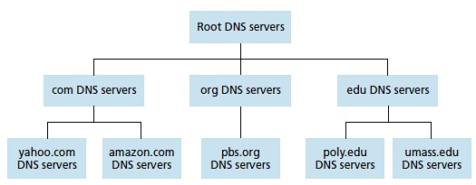
DNS - Example
DNS client wants to determine the IP address for the hostname www.amazon.com
The client first contacts one of the root servers, which returns IP addresses for TLD servers - top-level domain .com.
Then contacts TLD servers, which returns the IP address of an authoritative server for www.amazon.com
Finally, contacts one of the authoritative servers for www.amazon.com, which returns the IP address for the hostname www.amazon.com.

Slide 25
DNS: A distributed - hierarchical database
Root DNS Servers – Total 13

Slide 26
DNS – Cont…
Top-level domain (TLD) servers:
It is responsible for com, org, net, edu, aero, jobs, museums, and all top-level country domains, e.g.: uk, fr, ca, jp
Network Solutions maintains servers for .com TLD
Education for .edu TLD
Authoritative DNS servers:
To organization’s own DNS servers, providing authoritative hostname to IP mappings for organization’s named hosts.
It can be maintained by organization or service provider.
Local DNS name servers:
It does not strictly belong to hierarchy
when host makes DNS query, query is sent to its local DNS server.
It acts as proxy, forwards query into hierarchy.

Slide 27
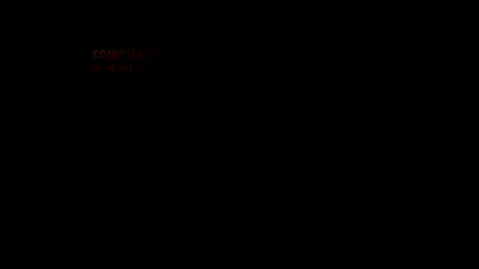
DNS - Example

Slide 28

DNS Name Resolution Example
Iterated Query:
A host at cis.poly.edu wants IP address for gaia.cs.umass.edu
root DNS server
2
3
TLD DNS server
4
5
local DNS server
dns.poly.edu
7
6
1
8
authoritative DNS server
dns.cs.umass.edu
requesting host
cis.poly.edu
gaia.cs.umass.edu

Slide 29
DNS Name Resolution Example
Recursive Query:
A host at cis.poly.edu wants IP address for gaia.cs.umass.edu
root DNS server
2
3
7
6
TLD DNS
server
local DNS server
dns.poly.edu
5
4
1
8
authoritative DNS server
dns.cs.umass.edu
requesting host
cis.poly.edu
gaia.cs.umass.edu

Slide 30
DNS – Cont...
Distributed database design is more preferred over centralized design to implement DNS in the Internet.
A single point of failure: If the DNS server crashes then the entire Internet will not stop.
Traffic volume: With millions of device and users accessing its services from whole globe at the same time.
A Single DNS Server cannot handle huge DNS traffic but with distributed system its distributed and reduce overload on server.
Distant centralized database: A single DNS server cannot be “close to” all the querying clients.
If it is in New York City, then all queries from Australia must travel to the other side of the globe, perhaps over slow and congested links cause significant delays.
Maintenance: To keep records for all Internet hosts. it would have to be updated frequently to account for every new host.

Slide 31
Socket Programming

Slide 32

Socket Programming
Socket is interface between application and network.
An application creates a socket.
Two type of socket:
TCP Socket – Reliable Transmission
UDP Socket – Unreliable Transmission
Once configured the application can pass data to the socket for transmission and receive data from the socket (transmitted through the network by some other host).
application
socket
application
controlled by
app developer
process
process
transport
transport
network
network
controlled
by OS
link
Internet
link
physical
physical

Slide 33
Type of Socket
SOCK_STREAM
E.g. TCP
Reliable delivery
In-order guaranteed
Connection-oriented
Bidirectional
SOCK_DGRAM
E.g. UDP
Unreliable delivery
No order guarantees
Connection-less
Unidirectional
App
D1
App
3
2
3
1
2
D2
socket
Dest.
1
socket
D3

Slide 34
Client-Server socket interaction: UDP
server (running on serverIP)
client
create socket:
create socket, port= x:
clientSocket =
socket(AF_INET,SOCK_DGRAM)
serverSocket =
socket(AF_INET,SOCK_DGRAM)
Create datagram with server IP and
port=x; send datagram via clientSocket
read datagram from
serverSocket
write reply to
serverSocket
specifying client address,
port number
read datagram from
clientSocket
close
clientSocket

Slide 35
Client-Server socket interaction: TCP
server (running on hostid)
client
create socket,
port=x, for incoming request:
serverSocket = socket()
wait for incoming
connection request
TCP
connection setup
create socket,
connect to hostid, port=x
connectionSocket =
serverSocket.accept()
clientSocket = socket()
send request using
clientSocket
read request from
connectionSocket
write reply to
connectionSocket
read reply from
clientSocket
close
connectionSocket
close
clientSocket

Slide 36
Outline - Summary
Principles of Computer Applications
Browser, Web Server, Email, P2P Applications etc…
Application Layer (TCP – UDP Services)
Web (Web Pages – Objects like html, jpeg, mp3, etc…)
HTTP (TCP connection, port-80, persistent & non-persistent conn.), Request & Response Message format, Cookies, Web caches, FTP, Port-21
E-mail (User agent, Mail Server, SMTP port - 25), POP3, IMAP
DNS (Domain names to IP Address), hierarchy structure
Socket programming with TCP and UDP (TCP – Sock_Stream, UDP – Sock_DGram)

Slide 37

Computer Networks (CN)
GTU #3150710
Prof. Maulik Trivedi
Computer Engineering Department
maulik.trivedi@darshan.ac.in
9998265805

